Slide 1
LOGISTIC REGRESSION

Slide 2
Introduction
A type of classification algorithm
Based on Linear Regression to evaluate output and minimize the error.
Named after the method it uses to evaluate the outputs the Logit Function

Slide 3
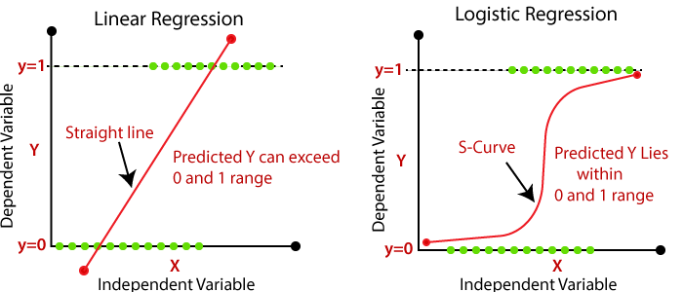

Slide 4
Training data assumptions for logistic regression
The predicted outcome is strictly binary or dichotomous. (This applies to binary logistic regression).
The factors, or the independent variables, that influence the outcome are independent of each other. In other words, there is little or no multicollinearity among the independent variables.
The independent variables can be linearly related to the log odds.
Fairly large sample sizes.

Slide 5
Uses of Logistic Regression
in drug research to check the effectiveness of medicines on health outcomes across age, gender and ethnicity;
in weather forecasting apps to predict snowfall and weather conditions;
in political polls to determine if voters will vote for a particular candidate;
in banking to predict the chances that a loan applicant will default on a loan or not, based on annual income, past defaults and past debts.

Slide 6
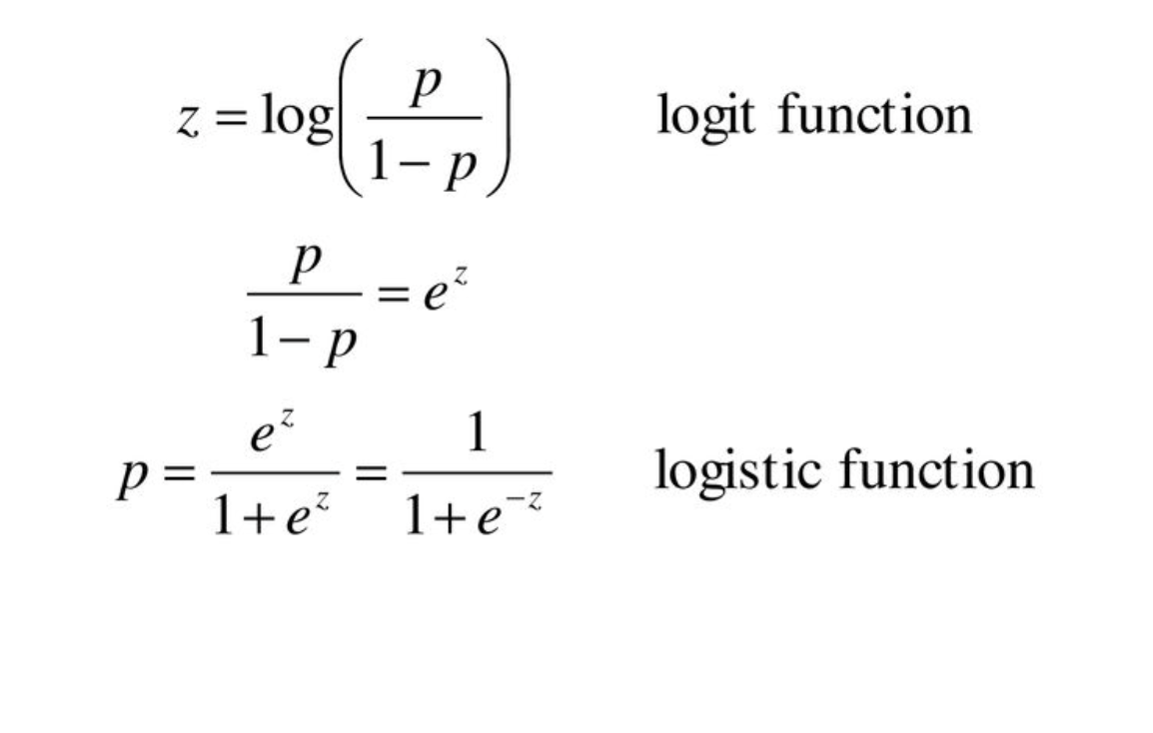
Logit and Logistic Function
p is the probability of success
1-p is the probability if failure

Slide 7
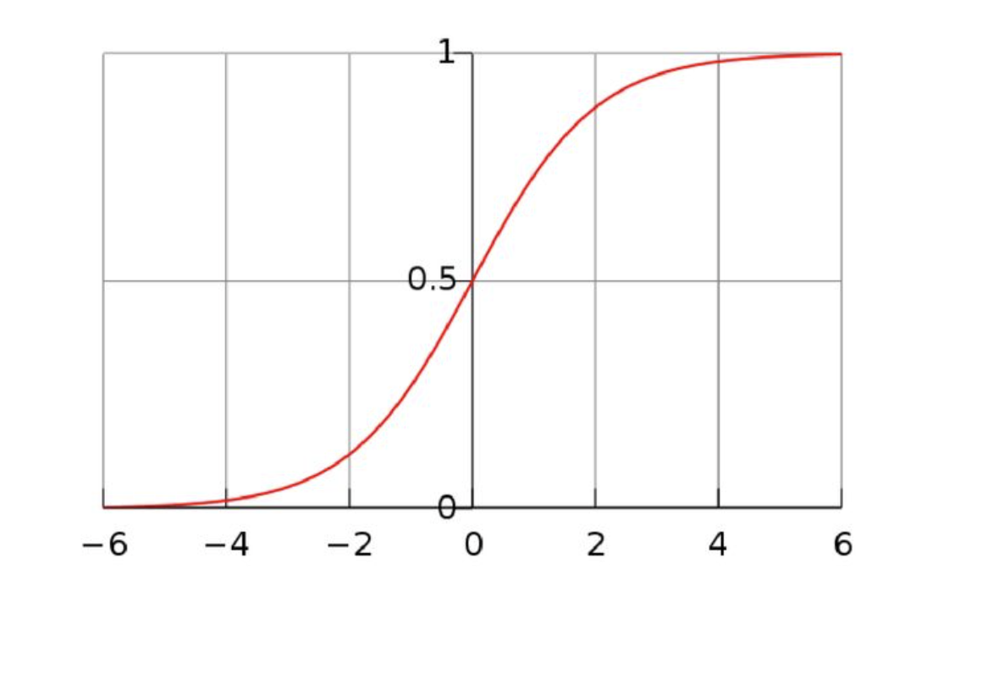
Standard Logistic Function

Slide 8
How to Best Evaluate a Classification Model
Classification accuracy
Confusion matrix
Precision and recall
F1 score

Slide 9
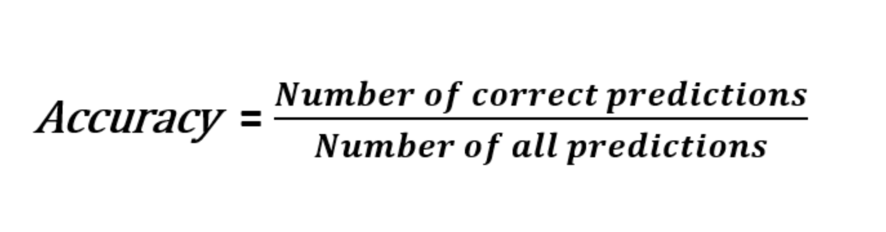
Accuracy

Slide 10
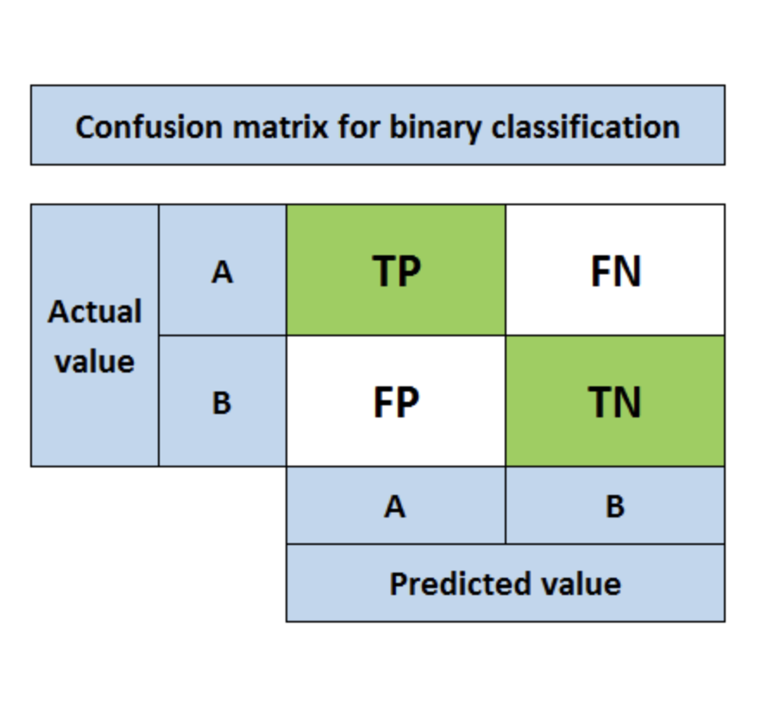
Confusion matrix

Slide 11
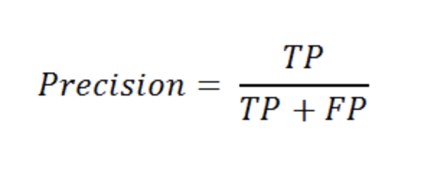
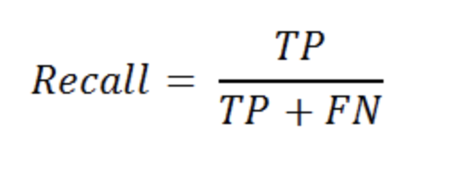
Precision and Recall

Slide 12
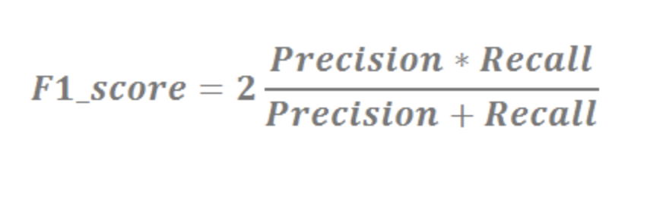
F1 Score

Slide 13
Regularization
Regularization is often used as a solution to the overfitting problem in Machine Learning.
Common causes for overfitting are
When the model is complex enough that it starts modeling the noise in the training data.
When the training data is relatively small and is an insufficient representation of the underlying distribution that it is sampled from, the model fails to learn a generalizable mapping.

Slide 14
Types of Regularization
Modify loss Function
  L2 Regularization
  L1 Regularization
  Entropy Regularization
Modify sampling method
  Data Augmentation
  K – fold Cross Validation

